Slide 1


Travel. See the world. Discover your opportunities to go abroad!
PhD Day 2024
Mgr. Kristýna Bajgarová, SCI MU
Tato fotka od autora Neznámý autor s licencí CC BY-NC

Slide 2

WHY?
WHY NOT!

Slide 3
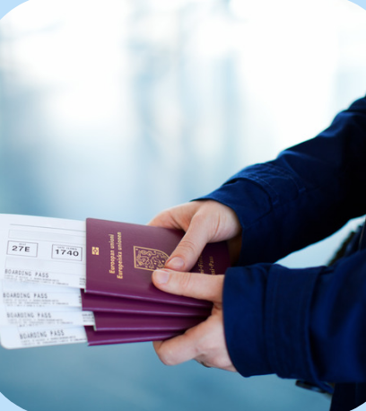
Why should I go abroad?
A unique experience that will give you an insight into living and studying/working abroad
Gain a competitive advantage on the job market
The uniqueness of staying abroad
New approaches and methods, broaden your horizons in your field
Improving your language skills
Creating new contacts, international connections
Possibility to choose any place for your stay abroad – an institution you would like to cooperate with in the future
Mandatory stay abroad for at least 1 month
( = 30 days)

Slide 4

Types of stays - 2 main options:
Interships/Traineeships – gaining work experience, practical work on your individual research projects, learning new methods etc.
Study stays – not very usual in the framework of doctoral studies, 1-2 semesters long study stays during which students enrol courses at the host university, mainly relevant for BSc and MSc students

Slide 5

Ok, I am convinced! What are my next steps?
Read this: Mobility process in general
You can find all the information here (MUNI SCI Student section)
Browse the web – for example, take a look here or here
Check MUNI Portal
Be brave and contact any institution you are interested in
TOP 300 world universities (QS ranking)
Discuss it with your supervisor
Stop by for a consulation if you‘d like to

Slide 6
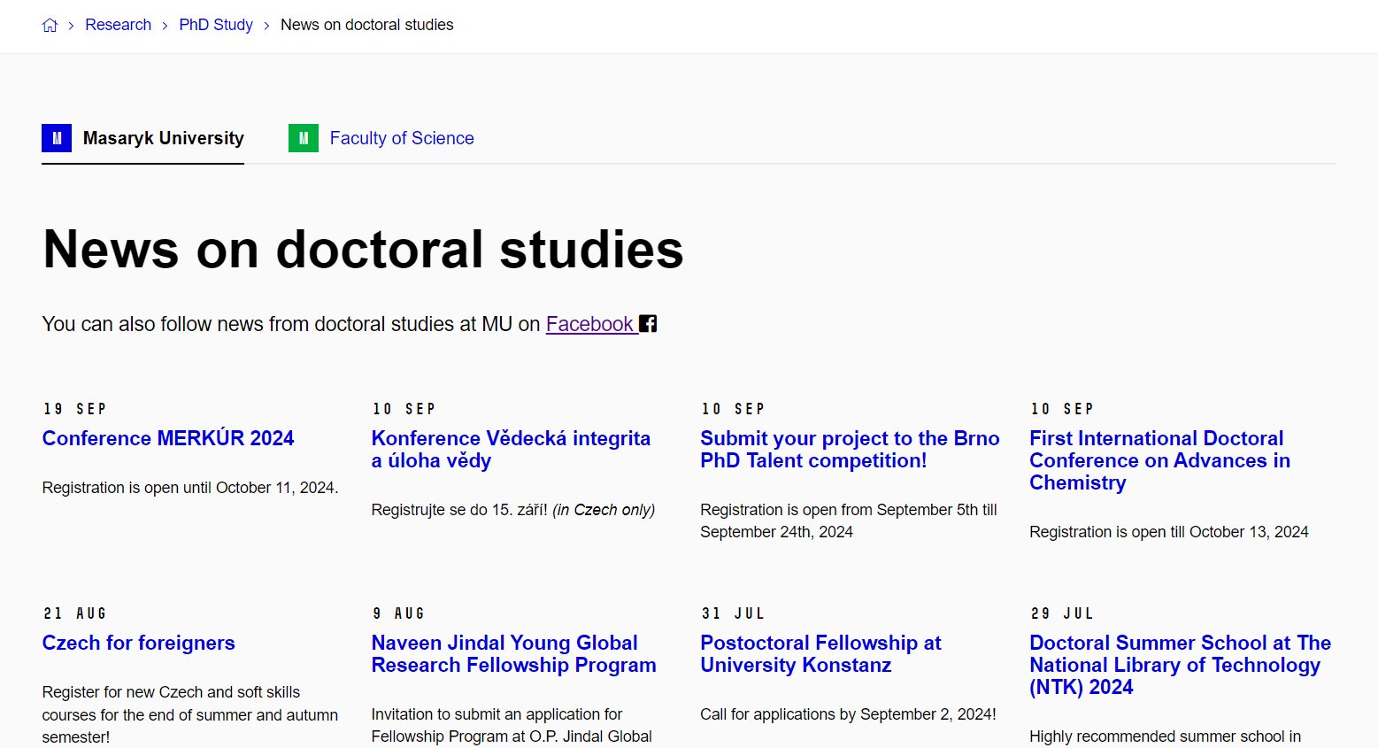
MU Portal

Slide 7

Scholarships
Specific scholarship for mobility programme (Erasmus+, Freemover,…)
Faculty scholarship
Scientific Exchange Grants, EMBO
Barrande Fellowship Program
DAAD, AKTION, DZS/AIA offers

Slide 8
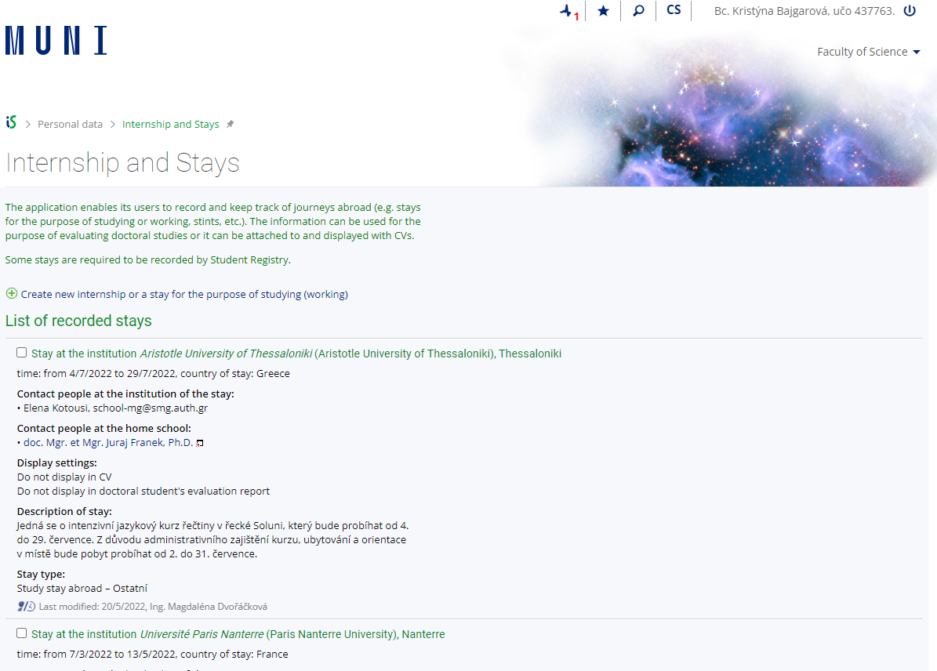
Recognition and Evidence
Every placement abroad as part of studies at MU is considered a study stay or a traineeship. In both cases, this mobility must be part of the study and therefore recognized within the study at MU.
Information here

Slide 9

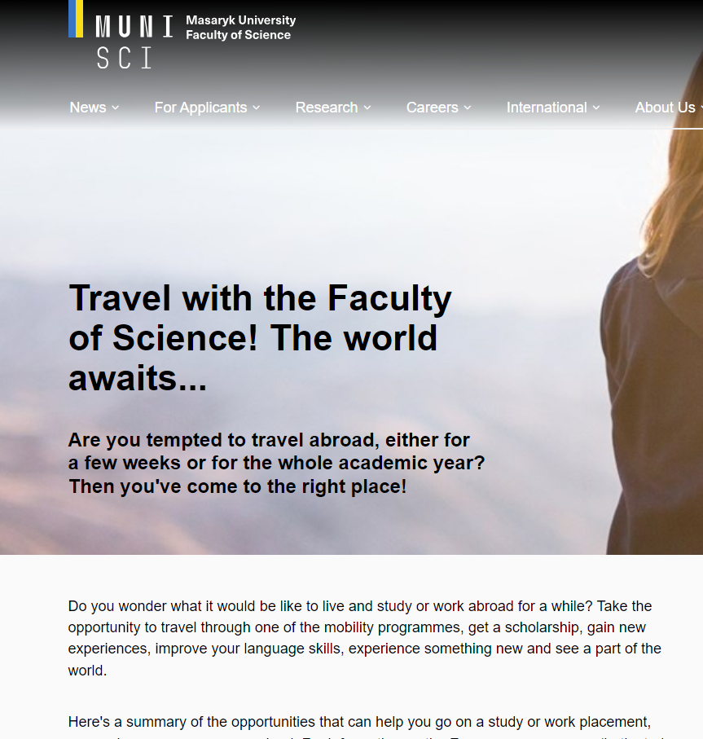
Where will I find information?
Faculty web
Academic Information Agency
Centre for International Cooperation
MU Portal
PhD newsletter
Some other scholarship options
Do světa MUNI (so far, only in Czech)
International Office SCI MU (ask us anytime!)
Department coordinators

Slide 10

Is there anything you want to ask?

Slide 11
Our Contact
International Relations
A: Kotlářská 2, building 1, room 01006
Campus, building B17, room 415
Common email: int@sci.muni.cz
Kristýna Bajgarová: bajgarova@sci.muni.cz

Slide 12


